Slide 1
AWV Analysis and Recommendations
March 21, 2019

Slide 2
Agenda
01
02
AWV Analysis and Research Findings
Recommendations for QIO, AWV Adoption Campaign

Slide 3
AWV Analysis and Research
DE Primary Care Practices, 2016
Dataset Analysis
Based on provided dataset, correlation assessment between patient risk and cost cannot be performed
Dataset does allow targeted engagement with practices based on
Unique Beneficiary Volume
Average Beneficiary Risk
Services Provided (AWV)
Research Findings
According to recent study published in American Journal of Managed Care^{[1]}, first time AWVs were associated with
$38 PMPM decrease overall in 11 month post AWV
$81 PMPM decrease in top HCC risk quartile
Primary savings found in Acute Care and Hospital OP (non ED) costs
Significant improvement in quality measures, especially in Fall and Depression risk screenings

Slide 4
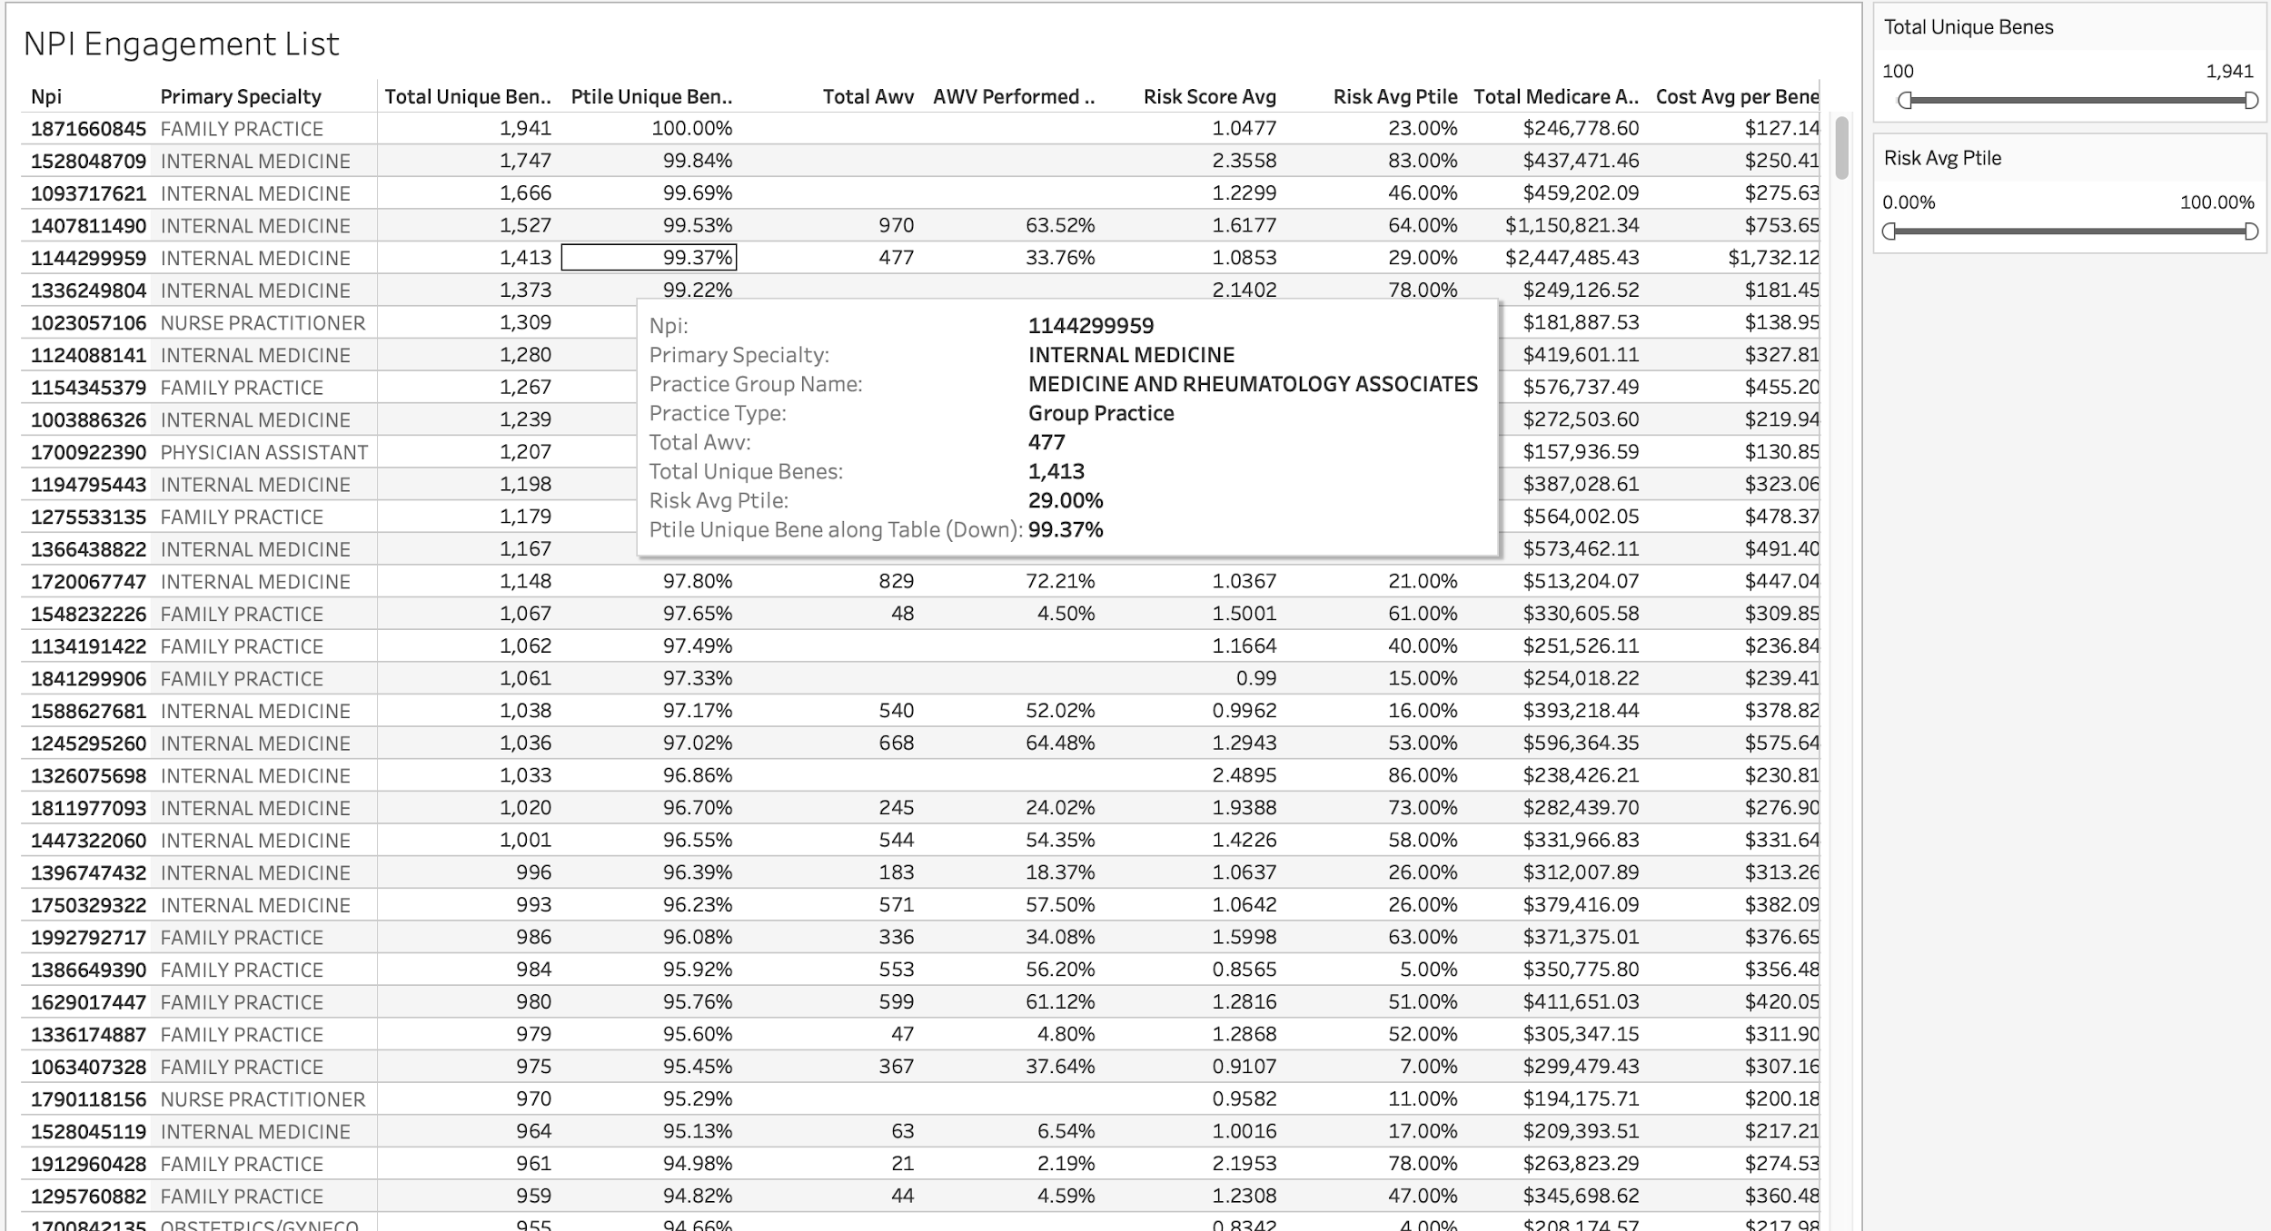
Recommendation for QIO
Targeted Practice Engagement for AWV Adoption
QIO can use the provided dashboard to target PCP engagement based on…
High volume of unique beneficiaries
High average risk (greater cost reduction)
Current percent of AWVs performed

Slide 5
Supporting Materials
CMS Annual Wellness Visit MLN Booklet
https://www.cms.gov/Outreach-and-Education/Medicare-Learning-Network-MLN/MLNProducts/Downloads/AWV_Chart_ICN905706.pdf
Medicare Annual Wellness Visit Association With Healthcare Quality and Costs
https://www.ajmc.com/journals/issue/2019/2019-vol25-n3/medicare-annual-wellness-visit-association-with-healthcare-quality-and-costs

Slide 6
Appendix

Slide 7
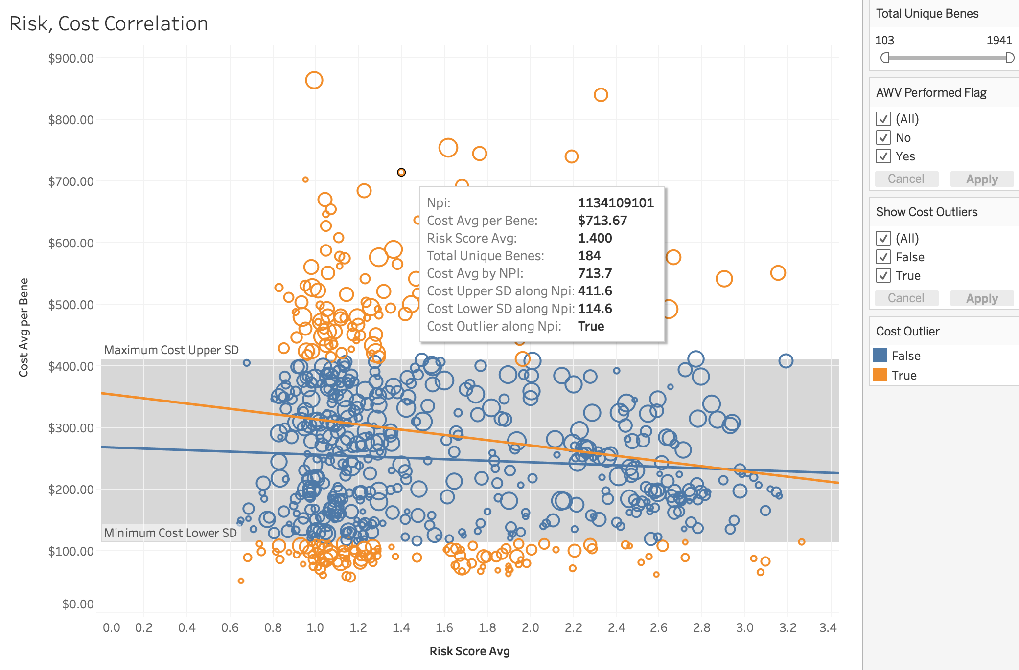
Dataset Analysis
Aledade team reference only…

